Slide 1

SecureConnect: Revolutionizing Security in Kenya
Empowering freelance security experts, ensuring peace of mind for clients.

Slide 2

THE REAL CHALLENGE
Fragmented Security Market in Kenya
Kenya's security sector, while vital, suffers from significant inefficiencies.
Lack of Centralized Platform: Clients struggle to find vetted, reliable security professionals quickly.
Underemployed Experts: Skilled freelance security personnel often lack consistent work.
Trust and Transparency Issues: Verification of credentials and service quality is a major hurdle.

Slide 3




OUR ANSWER
Introducing SecureConnect
SecureConnect is a mobile application connecting vetted freelance security experts with clients requiring diverse security services.
Seamless Booking
Verified Experts
Instant access to a network of professionals.
Rigorous vetting ensures trustworthiness.
Transparent Ratings
Flexible Payments
Client reviews ensure quality and accountability.
Secure in-app transactions for peace of mind.

Slide 4
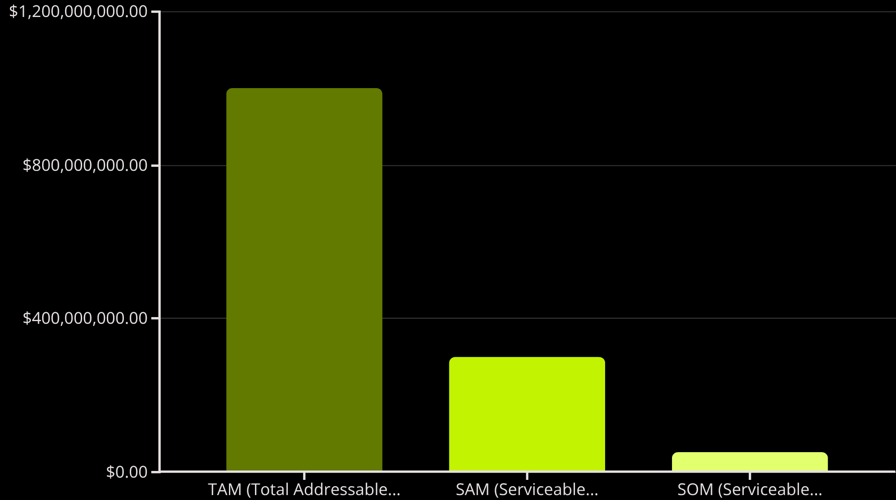
THE BIG PICTURE
Vast Market Opportunity
The security services market in Kenya is valued at over $1 Billion USD, driven by rising urbanization and business growth.
TAM: All security services in Kenya.
SAM: Digital platform-eligible services.
SOM: Our achievable market share within 3 years.

Slide 5
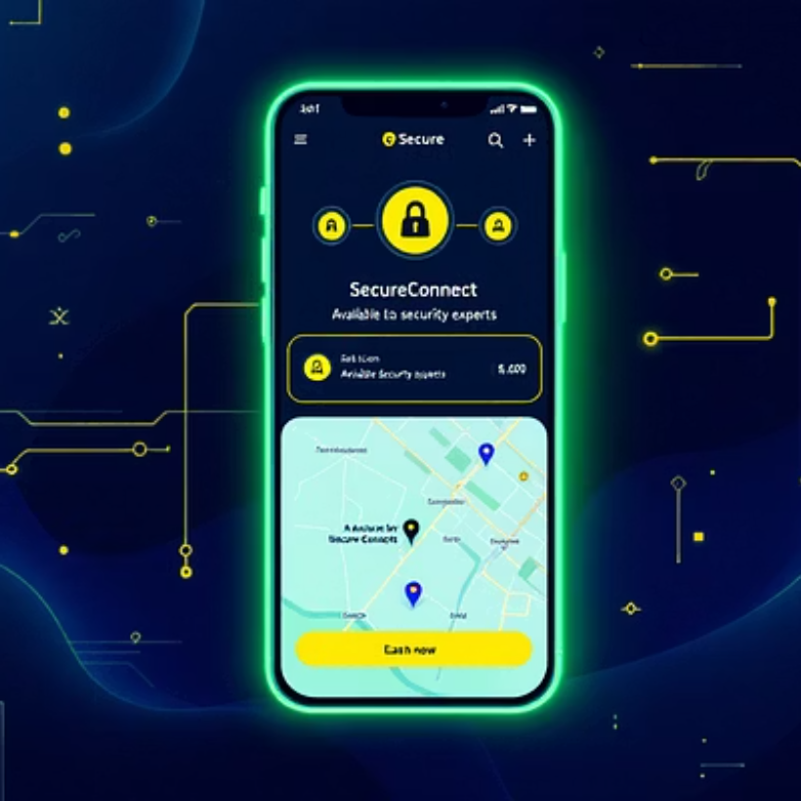
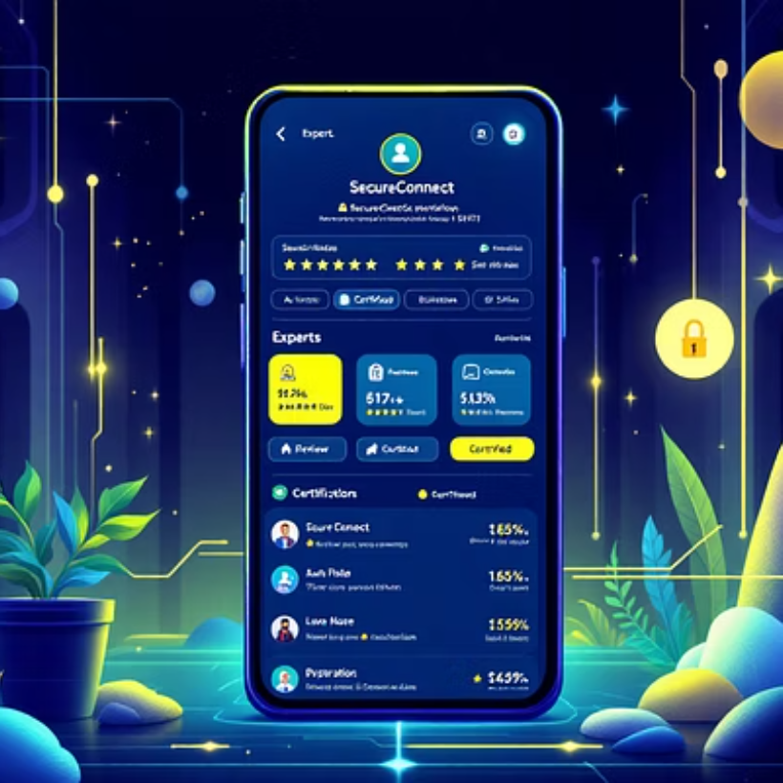
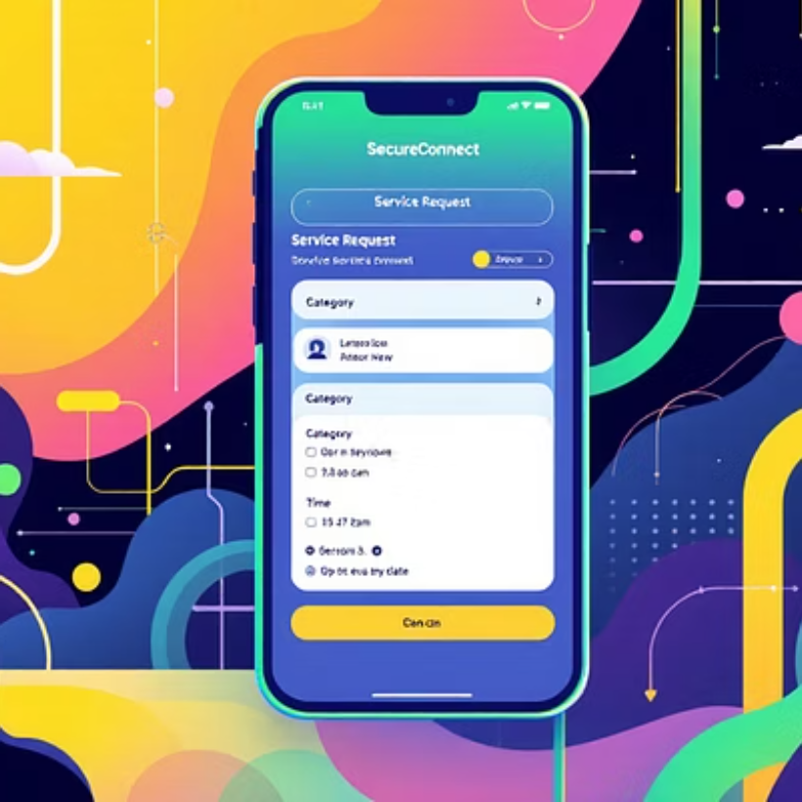
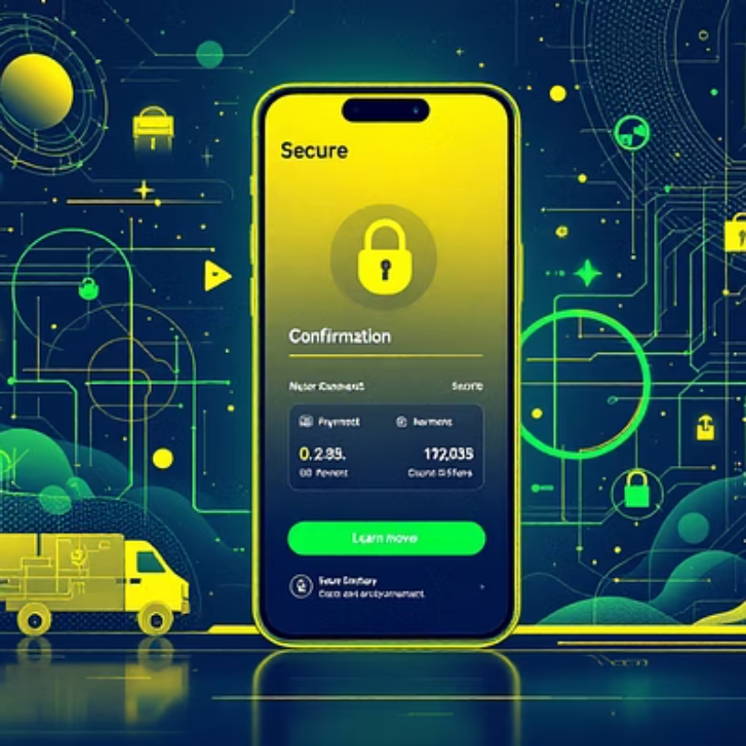
APP HIGHLIGHTS
SecureConnect Product Tour
Intuitive design, robust features, and seamless user experience from start to finish.

Slide 6



OUR STRATEGY
Sustainable Revenue Streams
Commission Fee
Premium Subscriptions
Certification Partnerships
A percentage from each successfully completed service.
For experts seeking enhanced profile visibility and analytics.
Revenue from optional specialized training and certification programs.
Diversified revenue model ensuring long-term profitability and scalability.

Slide 7
OUR JOURNEY SO FAR
Impressive Early Traction
5K+
10K+
4.8
30%
Registered Experts
Completed Jobs
Average Rating
MoM Growth
Satisfied clients across various security needs.
Consistent high quality service delivery.
Steady user and transaction growth.
Highly skilled and vetted security professionals.
Rapid growth and strong market validation demonstrate clear demand.

Slide 8
WHY WE WIN
Our Competitive Edge
Superior Vetting Process
User-Centric Platform
Unmatched background checks and credential verification for all experts.
Designed for ease of use by both clients and experts, ensuring seamless interactions.
Dedicated Local Support
Scalable Technology
24/7 customer service and expert assistance tailored for the Kenyan market.
Robust infrastructure built for rapid expansion across Kenya and beyond.

Slide 9



MEET THE VISIONARIES
Our Exceptional Team
Aisha Mohammed
Jomo Kenyatta Jr.
David Kimani
CEO & Co-Founder
Chief Security Officer & Co-Founder
CTO
10+ years in digital marketplace development and fintech.
Former police commander, 20+ years in security operations.
Full-stack developer with 8 years in scalable mobile app architecture.

Slide 10

JOIN OUR JOURNEY
Investment & Call to Action
Funding Ask: $1.5 Million USD
Seeking seed funding to scale operations, enhance features, and expand our market reach.
60% Technology Development & AI Integration
25% Marketing & User Acquisition
15% Operational Expansion & Team Growth
Contact Us: invest@secureconnect.co.ke secureconnect.co.ke

